Slide 1
19CSE102 Computer Programming
control structures : selection

Slide 2
Agenda
Relational and Logical operators
Ternary operator
Simple if
if …else
if else if ladder
Nested if
switch case

Slide 3
Control Structures
Control structures control the flow of execution in a program or function.
There are three kinds of execution flow:
Sequence:
the execution of the program is sequential.
Selection:
A control structure which chooses alternative to execute.
Repetition:
A control structure which repeats a group of statements.

Slide 4
Conditions
A program may choose among alternative statements by testing the value of key variables.
Condition is an expression that is either false (represented by 0) or true (represented by 1).
e.g., if mark is greater than 50
print “Pass”
Conditions may contain relational or equality operators, and have the following forms.
variable relational-operator variable (or constant)
variable equality-operator variable (or constant)

Slide 5





Operators Used in Conditions
Operator | Meaning | Type
< | Less than | Relational
> | Greater than | Relational
<= | Less than or equal to | Relational
>= | Greater than or equal to | Relational
== | Equal to | Equality
!= | Not equal to | Equality

Slide 6
Examples of Conditions
Operator | Condition | Meaning
<= | x <= 0 | x less than or equal to 0
< | Power < MAX_POW | Power less than MAX_POW
== | mom_or_dad == ‘P’ | mom_or_dad equal to ‘P’
!= | num != SENTINEL | num not equal to SENTINEL

Slide 7
Logical Operators
There are three kinds of logical operators.
&&: and
||: or
!: not
Logical expression is an expression which uses one or more logical operators, e.g.,
(temperature > 90.0 && humidity > 0.90)
!(n <= 0 || n >= 100).

Slide 8
The Truth Table of Logical Operators
Op 1 | Op 2 | Op 1 && Op2 | Op 1 || Op2
nonzero | nonzero | 1 | 1
nonzero | 0 | 0 | 1
0 | nonzero | 0 | 1
0 | 0 | 0 | 0
Op 1 | ! Op 1
nonzero | 0
0 | 1

Slide 9
Operator Precedence
An operator’s precedence determines its order of evaluation.
Unary operator is an operator that has only one operand.
!, +(plus sign), -(minus sign), and &(address of)
They are evaluated second only after function calls.
Operator | Precedence
function calls | highest
! + - &
* / %
+ -
< <= >= >
== !=
&&
||
= | lowest

Slide 10
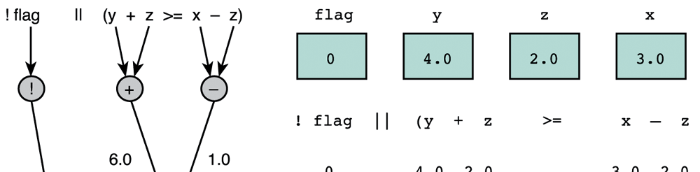
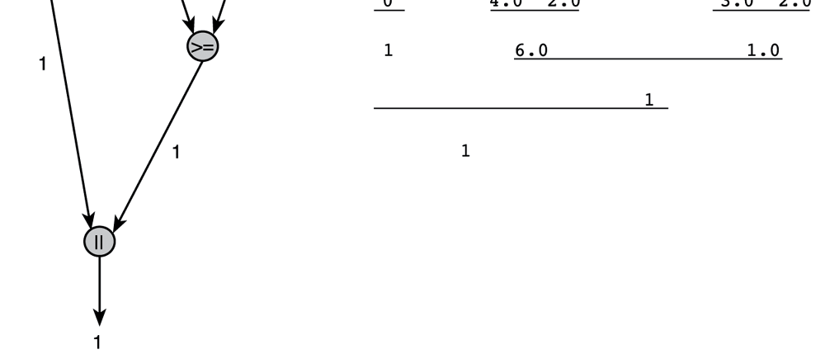
Evaluation for
!flag ||
(y + z >= x - z)
The result of this expression is true
Evaluation tree
Copyri
ght ©2004 Pearson Addison-Wesley. All rights reserved. 4-11

Slide 11
Comparing Characters
Expression | Value
‘9’ >= ‘0’ | 1 (true)
‘a’ < ‘e’ | 1 (true)
‘Z’ == ‘z’ | 0 (false)
‘a’ <= ‘A’ | 0(false)

Slide 12
De Morgan’s Theorem
De Morgan’s theorem gives us a way of transforming a logical expression into its complement.
The complement of expr₁ && expr₂ is comp₁ || comp₂, where comp₁ and comp₂ are the complement of expr₁ and expr₂, respectively.
The complement of expr₁ || expr₂ is comp₁ && comp₂.

Slide 13
Conditional Statements
Pseudocode example:
If student’s mark is greater than or equal to 60 Print “Passed”
If the condition is true
Print statement executed, program continues to next statement
If the condition is false
Print statement ignored, program continues

Slide 14
Flowchart of if statement
Translation into C
Marks>=50
true
Passed
false
if ( mark >= 50 )
printf(“You have passed in examination!\n”);
A decision can be made on any expression.
zero - false
nonzero – true
Example:
Mark=60 is true

Slide 15
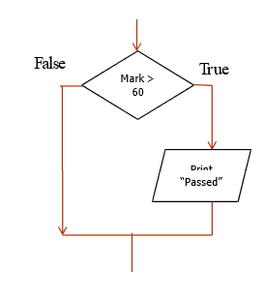
Single way selection if Statement
Syntax:
if (condition)
statement;
e.g. 1 : If student’s mark is greater than or equal to 50 Print “You have passed in examination”
if ( mark > 60 )
printf(“You have passed in examination!\n”);
e.g. 2 : If quantity is not equal to 0 calculate price as price * quantity print price
if (quantity!= 0.0 ){
price = price * quantity;
printf(“Price=Rs. %8.2f!\n”,price);
}

Slide 16
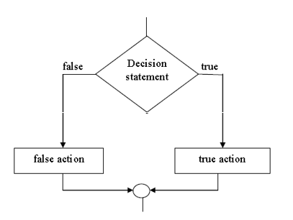
Two way selection if else Statement
The if else statement is the primary two way selection control structure.
Syntax:
if (condition)
statement;
else
statement;
e.g. 1
if ( mark > 50 )
printf(“You have passed in examination!\n”);
else
printf(“Sorry Try again!\n”);

Slide 17
e.g. 2
if (quantity!= 0.0 ){
price = price * quantity; printf(“Price=Rs. %8.2f!\n”,price);
}
else
printf(“Quantity is less than 0.0\n”);

Slide 18
Single way selection
if Statement
Write a C program to print the number entered by user only if the number entered is negative.
void main()
{
int num;
printf("Enter a number to check.\n");
scanf("%d",&num);
if(num<0) {
/* checking whether number is less than 0 or not. */
printf("Number = %d\n",num);
}
/*If test condition is true, statement above will be executed, otherwise it will not be executed */
printf("The if statement in C programming is easy.");
return 0;
}

Slide 19
Two way selection
if else Statement
Write a C program to print the number entered by user only if the number entered is positive or negative.
void main(){
int num;
printf("Enter a number to check.\n");
scanf("%d",&num);
if(num<0) {
/* checking whether number is less than 0 or not. */
printf(“Negative Number = %d\n",num);
}
else{
/ *If test condition is false statement */
printf(“Positive Number = %d\n",num);
}
return 0;
}

Slide 20
Two way selection
if else Statement
Write a C program to print the number entered by user only if the number entered is even or odd.
void main()
{
int num;
printf("Enter a number to check.\n");
scanf("%d",&num);
if(num%2==0) {
/* checking whether number is odd or even. */
printf(“Even Number = %d\n",num);
}
else{
/*If test condition is false statement */
printf(“OddNumber = %d\n",num);
}
return 0;
}

Slide 21
if/else Selection Structure
23
Ternary conditional operator (?:)
Three arguments (condition, value if true, value if false)
Code could be written:
( mark >= 60 ? printf(“Passed”) : printf(“Failed”);
Condition
Value if true
Value if false
false
mark >= 60
true
print “Failed”
print
“Passed”

Slide 22
Combining condition with logical operators
If both conditions need to be true use logical AND ( &&
)operator
If first condition is false second condition not evaluate.
If only one of the condition true use logical OR (|| ) operator
If first condition is true second condition not evaluated.
Logical AND ( && ) and logical OR (|| ) act as short circuiting operators.

Slide 23
Combining condition with logical operators
e.g. 1
/* if condition 1 is true condition 2 will be evaluated*/
if((road_status == ‘S’) &&(temp>0) )
printf(“Wet roads ahead!\n”);
else
printf(“Drive carefully!\n”);
e.g. 2
/* if condition 1 is true condition 2 will not be evaluated*/
if((road_status == ‘S’) ||(temp>0) )
printf(“Wet roads ahead!\n”);
else
printf(“Drive carefully!\n”);

Slide 24
Nested if Statements
Nested if statement is an if statement with another if statement as its true task or false task.
e.g.,
if (road_status == ‘S’)
if(temp > 0) {
printf(“Wet roads ahead!\n”);
}else{
printf(“Icy roads ahead!\n”);
}
else
printf(“Drive carefully!\n”);

Slide 25
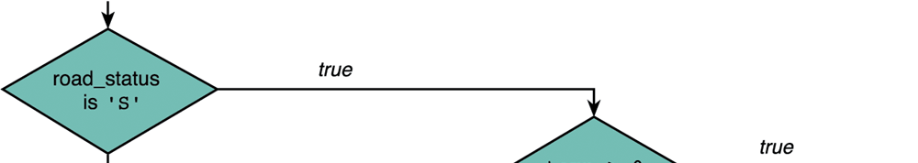
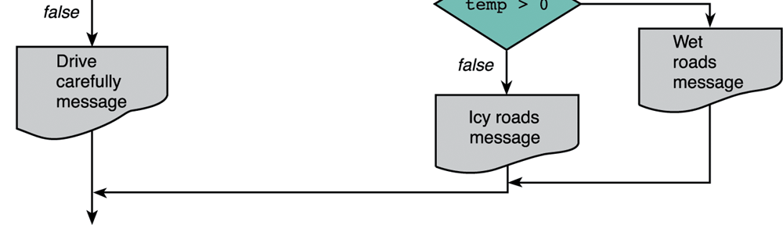
An Example for the Flowchart of Nested if Statements
Another if statement
Main if statement

Slide 26
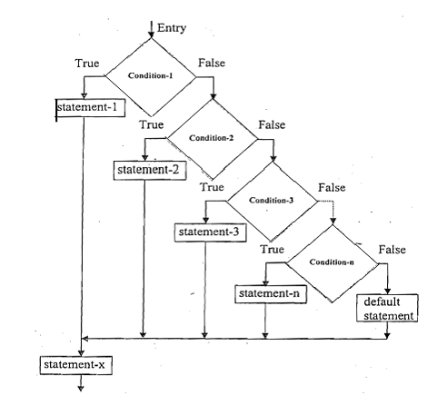
Multiway Decision Making statements
If there are many alternatives, it is better to use the syntax of multiway decision.
if else if ladder
switch case

Slide 27
Multiway Decision Making statements if else if ladder
Syntax:
if(condition 1) {
statements; /∗ statements will execute if the condition 1 is true ∗/
}
else if(condition 2) {
statements; /∗ statements will execute if the condition 2 is true ∗/
}
else if(condition 3) {
statements; /∗ statements will execute if the condition 3 is true ∗/
}
else if(condition n) {
statements; /∗ statements will execute if the condition n is true ∗/
}
else {
statements; /∗ statements will execute if all conditions are false ∗/
}

Slide 28
Multiway Decision-Making statements if else if ladder
Write a C program to check if a number is positive negative or zero
void main() { int num;
printf("Enter a number = "); scanf("%d",&num);
if(num>0) {
printf("Number is Positive");
}
else if(num<0) {
printf("Number is Negative");
}
else {
printf("Number is Zero");
}
return 0; }

Slide 29
Multiway-Selection Structure
switch case
Useful when variable or expression is tested for multiple values.
Consists of a series of case labels and an optional default
Case.
Break is (almost always) necessary- It is used to terminate a case in the switch statement

Slide 30
The switch Statement
The switch statement is used to select one of several alternatives
when the selection is based on the value of a single variable or
an expression.
switch (controlling expression) {
case label₁:
statement₁
break;
If the result of this controlling expression
case label₂:
matches label , execute staement and then break
1 1
statement₂
break;
…
this switch block.
case label_{n}:
statement_{n}
break; default:
statement_{d};
}
If the result matches none of all labels, execute the default statement_{d}.

Slide 31
switch case and if else if ladder
switch (expression) {
case val1:
statement break;
case val2:
statement break;
….
if (expression == val1) statement
else if (expression==val2) statement
….
else if (expression== valn)
statement
statement
case valn:
statement break;
default:
statement break;
else
}

Slide 32
Flowchart switch case
true
case a
case a action(s)
break
false
case b
true
case b action(s)
break
false
.
.
.
true
Case z
case z action(s)
break
case z
false
default action(s)

Slide 33
An Example of a switch Statement with Type
numeric(int) Case Labels
/* Print the day based on the number entered*/ void main() {
int day;
printf(“Enter the day of the week(1-7):”); scanf(“%d”,&day);
switch(day) {
case 1: printf(“Sunday\n”); break;
case 2: printf(“Monday\n”); break;
case 3: printf(“Tuesday\n”); break;
case 4: printf(“Wednesday\n”); break;
case 5: printf(“Thursday\n”); break;
case 6: printf(“Friday\n”); break;
case 7: printf(“Saturday\n”); break;
default: printf(“Incorrect entry Try again!\n”);
}
}

Slide 34
An Example of a switch Statement with Type
char Case Labels
Write a program to enter the ship name based on the character entered.
If it is B or b Battleship If it is C or c Cruiser
If it is D or d Destroyer If it is F or f Frigate
If it is not any of the letter print unknown ship

Slide 35
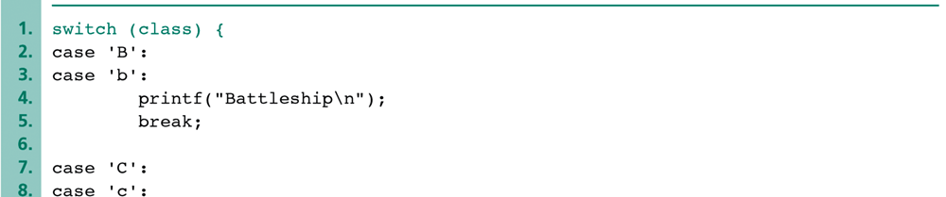
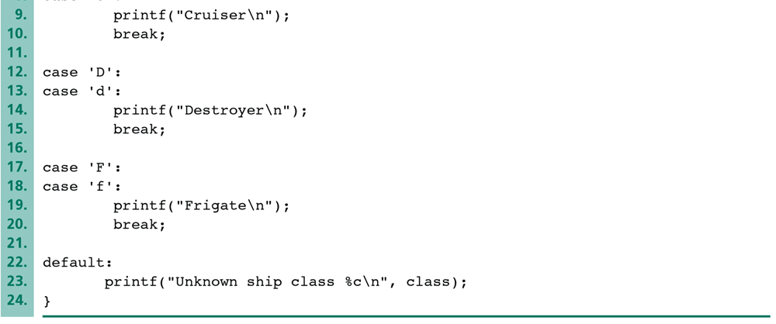
An Example of a switch Statement with Type char Case Labels
class is a char variable.
Two or more cases can execute the same statement.
Copyright ©2004 Pearson Addison-Wesley. All rights reserved.
4-41

Slide 36
Rules to be followed for switch case
Case doesn’t always need to have order 1, 2, 3 and so on. It can have any integer value after case keyword. Also, case doesn’t need to be in an ascending order always, you can specify them in any order as per the need of the program.
Character labels can be used in switch case.
Valid expressions for switch
switch(1+2+23)
switch(1*2+3%4)
Invalid switch expressions
switch(ab+cd) switch(a+b+c)
Nesting of switch statements are allowed, which means you can have switch statements inside another switch. However nested switch statements should be avoided as it makes program more complex and less readable.

Slide 37
Predict the output
void main() {
int i=2;
switch (i) {
case 1: printf("Case1 ");
case 2: printf("Case2 ");
case 3: printf("Case3 ");
case 4: printf("Case4 ");
default: printf("Default ");
}
return 0;
}

Slide 38
Predict the output
void main() { int i=2; switch (i) {
case 1: printf("Case1 ");
case 2: printf("Case2 "); case 3: printf("Case3 "); case 4: printf("Case4 "); default: printf("Default ");
}
return 0;
}
Output: Case2 Case3 Case4 Default
Reason: No break statement .It will execute the first matching case and then all the case statements below it.
49
Department of CSE

Slide 39
Predict the output
What will be the output of the following code fragment?
int year; scanf(“%d”,&year);
if(year%100==0)
{
if(year%400==0)
printf(“leap year\n“);
}
else
printf(“not leap year\n“);
if the input given is (i)2000 (ii)1900 (iii) 19

Slide 40
Predict the output
What will be the output of the following code fragment?
int year;
scanf(“%d”,&year);
if(year%100==0)
{
if(year%400==0)
printf(“leap year\n“);
}
else
printf(“not leap year\n“);
if the input given is (i)2000 (ii)1900 (iii) 19
Ans.
(i)leap year
(ii) No output
(iii) not leap year

Slide 41
Try it yourself
1.Write a program to enter the temperature and print the following message according to the given temperature by using if else ladder statement.
1.T<=0
2. 0 < T < 10
3. 10 < T < =20
"Its very very cold". "Its cold".
"Its cool out".
4. 20 < T < =30
5. T>30
"Its warm". "Its hot".
Department of CSE
42

Slide 42

Try itYourself
Convert the following if –else loop into switch…case.
if ( grade == 'A' || grade == 'a' )
++aCount;
else if ( grade == 'B' || grade == 'b' )
++bCount;
else if ( grade == 'C' || grade == 'c' )
++cCount;
else if ( grade == 'D' || grade == 'd' )
++dCount; else {
printf( "Incorrect letter grade entered." ); printf( " Enter a new grade.\n" );

